Slide 1
MIKE 11
FEH Editor
Flood Estimation Handbook – RR Editor

Slide 2
Flood Estimation Handbook
Overview:
Five volumes:
Overview
Rainfall Frequency Estimation
Statistical Procedures for Flood Frequency estimation
The Flood Studies Report (FSR) rainfall-runoff method
Catchment Descriptors
Two CDs:
FEH CD-ROM: Digital descriptors for all catchments in the UK
WINFAP-FEH: Statistical analysis to arrive at a T-year flood
MIKE 11
FEH main focus

Slide 3
The FEH Model
The MIKE 11 FEH model generates flood hydrographs based on catchment descriptors extracted from the FEH CD-ROM
Three main methods are available for hydrograph generation:
Generation of a T-year event
Generation of a Probable Maximum Flood (PMF)
Generation of an observed Flood Event

Slide 4
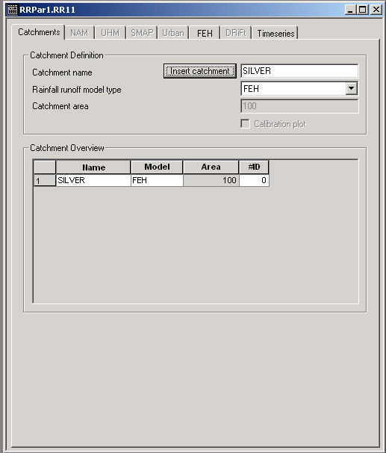
Modelling rainfall-runoff using FEH
(loss)
RR General User Interface
(loss)
(rapid response)

Slide 5
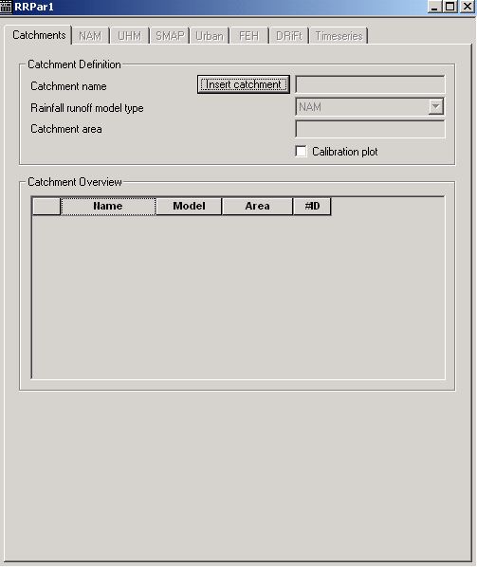
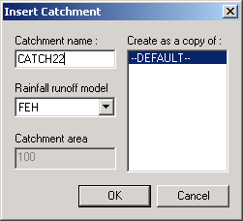
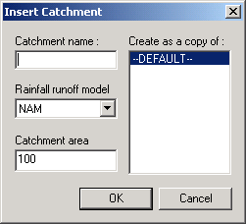
The M11-FEH Graphical User Interface
Defining a FEH catchment
Catchment area not required since area is defined through catchment descriptors

Slide 6
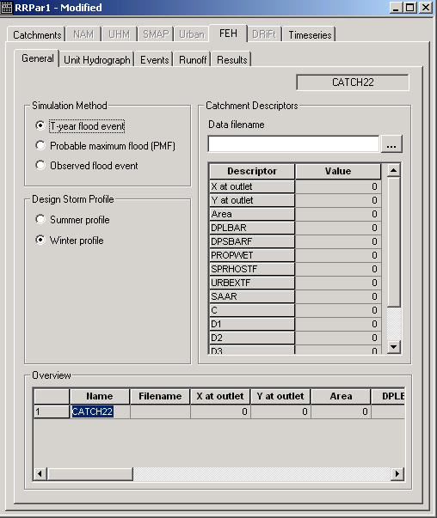
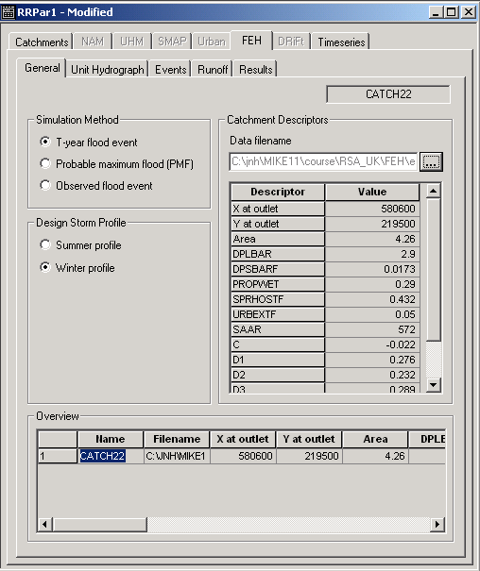
The M11-FEH Graphical User Interface
Choosing simulation mode
T-year storm event
Probable maximum flood (PMF)
Observed flood event
Catchment descriptors
Browse for comma separated file
Table shows catchment descriptors.
Table is non-editable
The design profile is found automatically based on the catchment descriptors.
May be edited by the user

Slide 7
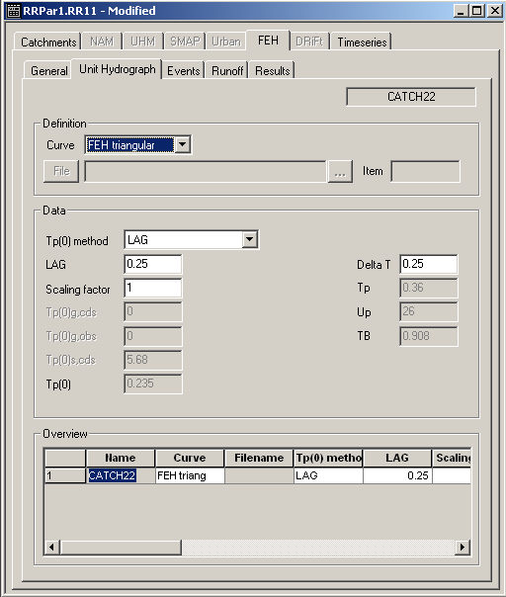
The M11-FEH Graphical User Interface
Choosing the unit hydrograph
FEH triangular
User defined
Choose the method by which the time to peak of the Instantaneous Unit Hydrograph
LAG: User specifies the LAG (hrs)
Catchment descriptors
Donor Catchment: User supplies observed Tp(0) and Tp(0) from catchment descriptors for Donor Catchment
Observations: The user supplies the time to peak

Slide 8
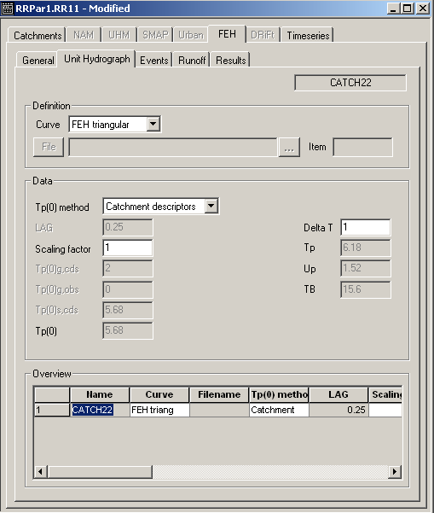
The M11-FEH Graphical User Interface
The data interval or time step used is calculated by the system. Determined as 20 % of Tp(0) rounded to the standard values of 0.25, 0.5, 1 or 2 hrs
Automatically calculated
Tp
Up
TB

Slide 9
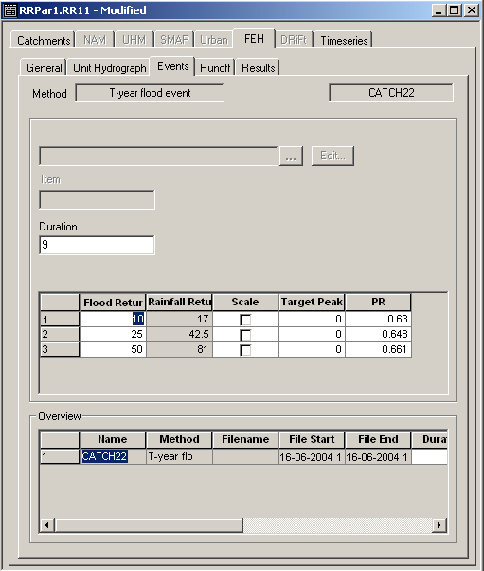
The M11-FEH Graphical User Interface
The rainfall duration is determined by the program from Tp(1+SAAR/1000)
May be edited by the user
Specify the return periods to be simulated. The corresponding rainfall periods are determined automatically through Fig. 3.2 in VOL 4 of the FEH.
Option for scaling peak of hydrograph
Percentage runoff (fraction). Automatically determined, may be edited by user

Slide 10
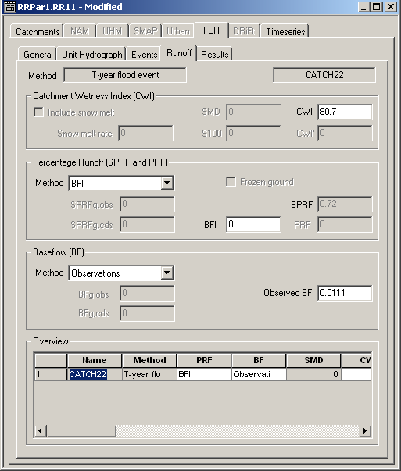
The M11-FEH Graphical User Interface
The catchment wetness index determined automatically through the use Fig. 3.7 in FEH Vol. 4 may be edited by the user
The percentage runoff may be determined through 4 methods:
BFI: Base flow index user specified
Catchment descriptors
Donor Catchment: Supply observed SPR and catchment descriptors determined SPR for gauged donor catchment
Observations

Slide 11
The M11-FEH Graphical User Interface
The Baseflow (the constant term):
Catchment descriptors
Donor Catchment: Supply observed BF and catchment descriptors determined BF from Donor(gauged) catchment
Observations: The user supplies the base flow (discharge)

Slide 12
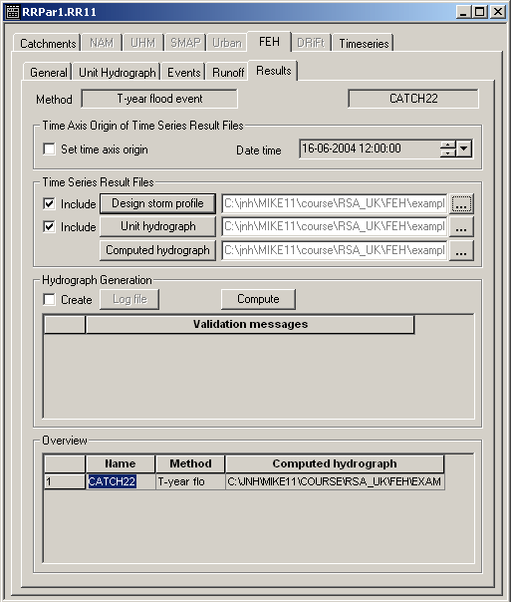
The M11-FEH Graphical User Interface
Set the time axis start if the results are to be tied in with a specific time and date. Otherwise the axis will be relative. Must be used if hydrograph is to be used in MIKE 11 HD
Specifying the result files
Design storm profile
Unit hydrograph
Computed hydrograph
Files must be created separately
The launch button

Slide 13
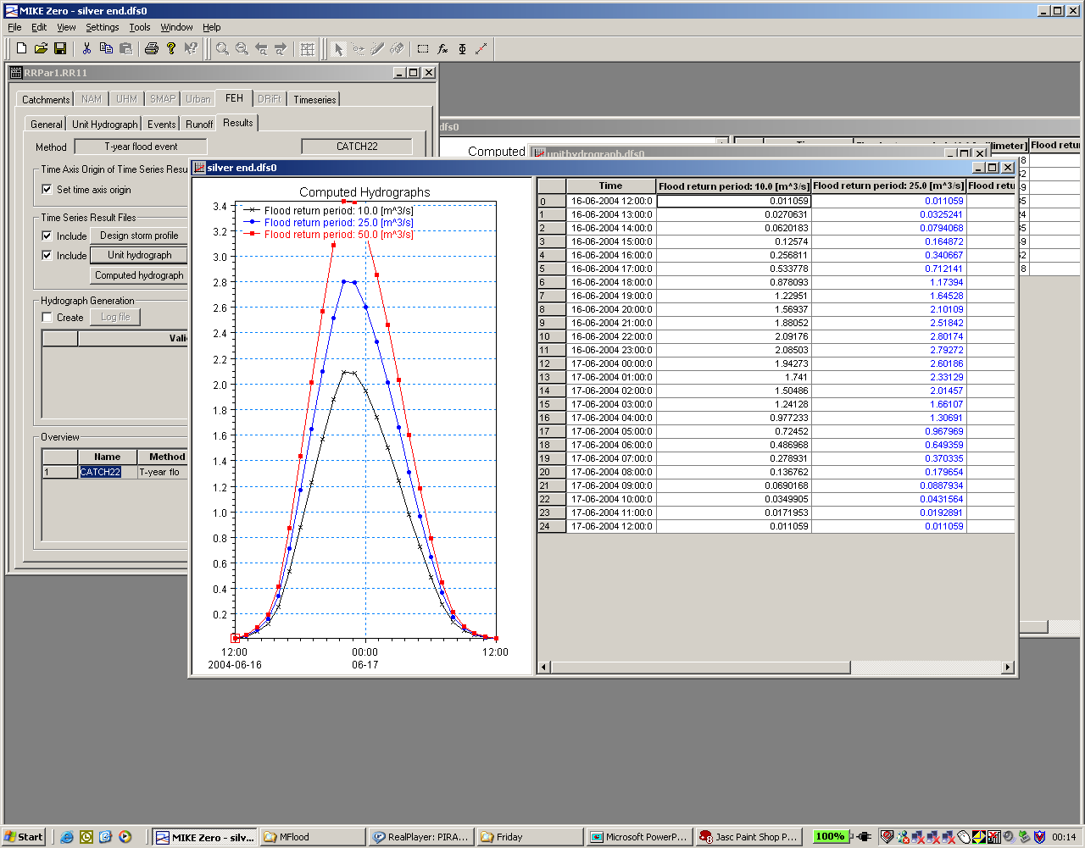
The M11-FEH Results

